Slide 1
Training Deep Neural Networks
Content in this presentation is largely based on 'Hands-on machine learning with sci-kit learn & Tensorflow', Aurelien Geron, O'reilly publishing
Gene Olafsen

Slide 2
Getting complex
This slide deck begins to consider ML models containing:
10+ layers
Each layer with hundreds of neurons
A model with hundreds of thousands of connections

Slide 3
challenges
Vanishing Gradients
Exploding Gradients
Both affect DNN and make lower layers difficult to train
Training may take a lot of time
Millions of parameters risk overfitting the training data set

Slide 4
Backpropagation
Backpropagation works its way from the output later (reverse) to the input later- propagating the error gradient on the way.
Having computed the gradient of the cost function for each parameter in the network- it utilizes these gradients to update each parameter with a Gradient Descent step.

Slide 5
Vanishing Gradients
Issue: Gradients often get continually smaller as the learning algorithms progress down to lower layers.
Problem: The Gradient Descent updates leaves the lower layer connection weights virtually unchanged.
Result: The training never converges to a good solution.
This is called the VANISHING GRADIENT problem.

Slide 6
Exploding Gradients
Issue: Sometimes gradients can grow bigger as the learning algorithms progress- this is mostly encountered in Recurrent Neural Networks. (RNN)
Problem: Many layers get insanely large weight updates
Result: The training algorithm diverges for an optimal solution.
This is called the EXPLODING GRADIENT problem.

Slide 7
Abandoned and then re-considered
The vanishing and exploding gradient issues resulted in neural network research being abandoned for a long time.
2010 - "Understanding the Difficulty of Training Deep Feedforward Neural Networks" was published by Xavier Glorot and Yoshua Begio.

Slide 8
THe suspects
Popular use of the sigmoid activation function.
Weight initialization scheme using random values using a mean of 0 and standard deviation of 1.

Slide 9
Decoding the problem
Utilizing the sigmoid activation function and initialization scheme resulted in the variance of the outputs of each layer is much greater than the inputs.
The variance continues increasing after each layer until the activation function saturates at the top layers.
This is further aggravated by the fact that the logistic function has a mean of 0.5 not 0.

Slide 10
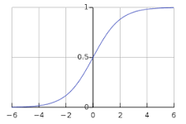
Activation visual
The function saturates at 0 or 1 with a derivative very close to 0.
Backpropagation has virtually no gradient to propagate back through the network. What little gradient exists, becomes diluted to an ineffective value at lower layers.

Slide 11
Xavier and He proposal
The signal needs to flow properly in both directions- forward when predicting and in reverse during backpropagation of gradients.
The signal should not die out.
The signal should not explode or saturate.
The variance of the outputs of each layer need to be equal to the variance of the inputs.
The gradients need to have equal variance before and after flowing through a layer in the reverse direction.

Slide 12
Proposal compromise
Guaranteeing equal variance through a layer and equal variance of outputs from inputs.
This is typically NOT possible unless the layer has an equal number of inputs and outputs.
Solution: The connection weights must be initialized randomly.
This initialization strategy is often referred to as Xavier Initialization.

Slide 13
Xavier initialization
Xavier initialization results in speeding up training considerably.
TensorFlow's tf.layers.dense() function utilizes Xavier initialization by default.

Slide 14
Activation Functions and HE initialization
The success of random weight initialization has let to similar strategies for activation functions.
The initialization strategy for ReLU activation function parameters utilizing random values is sometimes referred to He Initialization - identifying the person who's paper popularized this approach.

Slide 15
Nonsaturating activation functions
The Glorot and Bengio paper of 2010 identified the poor choice in selecting a 'biologically inspired' activation function- sigmoid.
However ReLU (Rectified Linear Unit) activation functions tend to be a better choice.

Slide 16
JUMP TO the 'Activation function' slide deck

Slide 17
Batch normalization
Though the various random initialization strategies presented earlier can initially reduce the vanishing/exploding gradient training problem... it doesn't guarantee that the issue won't come back during later training.
A 2015 paper by Ioffe and Szegedy proposed a technique called Batch Normalization (BN), addressing the vanishing/exploding gradient issue later in training.

Slide 18
Scaling and shifting
Batch Normalization consists of adding an operation in the model before the activation function of each layer.
The function zero-centers and normalizes the inputs, then scales and shifts the result utilizing two new parameters per layer. (scaling and shifting values)
This operation lets the model learn the optimal scale and mean of the inputs for each layer.
The whole training set must be utilized to compute the mean and standard deviation. (There is no mini-batch way of doing this.)

Slide 19
Batch Normalization in use
The vanishing gradients problem was strongly reduced (to the point where saturating activation functions can be used).
Removes the need for normalization of the input data.
The model networks are much less sensitive to weight initialization.
Much larger learning rates may be applied, speeding up the learning process.
Batch Normalization acts as a regularizer- which penalizes the loss function and reduces overfitting.

Slide 20
Batch normalization penalty
Adds some additional complexity to the model.
Neural networks will make slower predictions (due to the extra computations necessary at each layer.)

Slide 21
Batch Normalization in Code
See Jupyter Notebook...

Slide 22
Gradient clipping
Though this technique has fallen out of favor since Batch Normalization was introduced... a once popular technique to deal with exploding gradients was to simply clip the gradients during backpropagation so they never exceeded a predetermined threshold.
TensorFlow provides the clip_by_value function to perform the clipping function.

Slide 23
Reusing pretrained layers
It is always a good idea to try to locate an existing neural network that accomplishes a similar task, and re-using it, before endeavoring to train a very large DNN from scratch.
Reuse the lower layers of the pre-trained neural network.
This is known as transfer learning.
Greatly speeds up the training process.
Requires much less training data.

Slide 24
Reusing lower layers
Output Layer
An existing network which classifies pictures into 100 different categories.
A new DNN which will further classify one of the categories detected in the existing DNN
Input Layer
Output Layer
Hidden 4
Hidden 4
Hidden 3
Hidden 3
Hidden 2
Hidden 2
Hidden 1
Hidden 1
Input Layer
Input Layer
Existing DNN
New DNN

Slide 25
Model reuse tip
The inputs to the model for which you are borrowing the layers of an existing model must be the same.
For example, if the model classifies the contents of a specific size image, your model must provide images the same size.

Slide 26
Tensorflow and model reuse
Use the import_meta_graph() function to import an existing model's operations into the default graph.
If you created the model from which you want to borrow lower layers, then it should not take much time for you to identify the operations you want to export and re-use.
If however, the model is created by another person or group, you will have to explore the graph to identify the operations you want to borrow.

Slide 27
Tf.get_collection
with tf.name_scope("dnn"):
hidden1 = tf.layers.dense(X, n_hidden1, activation=tf.nn.relu, name="hidden1")
hidden2 = tf.layers.dense(hidden1, n_hidden2, activation=tf.nn.relu, name="hidden2")
hidden3 = tf.layers.dense(hidden2, n_hidden3, activation=tf.nn.relu, name="hidden3")
hidden4 = tf.layers.dense(hidden3, n_hidden4, activation=tf.nn.relu, name="hidden4")
hidden5 = tf.layers.dense(hidden4, n_hidden5, activation=tf.nn.relu, name="hidden5")
logits = tf.layers.dense(hidden5, n_outputs, name="outputs")
reuse_vars = tf.get_collection(tf.GraphKeys.GLOBAL_VARIABLES,
scope="hidden[123]") # regular expression

Slide 28
Freezing lower layers
Output Layer
When reusing an existing DNN's lower layers- which have already been trained to detect low-level features... it is best to freeze their weights when training the new DNN.
With the lower-level weights fixed, the higher layer weights will be easier to train (because they won't have to learn a moving target.)
Input Layer
Output Layer
Hidden 4
Hidden 4
Hidden 3
Hidden 3
Hidden 2
Freeze
Hidden 2
Hidden 1
Freeze
Hidden 1
Input Layer
Input Layer
Existing DNN
New DNN

Slide 29
Freeze with get_collection
with tf.name_scope("train"):
optimizer = tf.train.GradientDescentOptimizer(learning_rate)
train_vars = tf.get_collection(tf.GraphKeys.TRAINABLE_VARIABLES,
scope="hidden[34]|outputs")
training_op = optimizer.minimize(loss, var_list=train_vars)
Layers 3 & 4 are selected and passed to the optimizer's minimize function.
Layers 1 & 2 are not included and are effectively frozen.

Slide 30
Freeze with stop_gradient()
with tf.name_scope("dnn"):
hidden1 = tf.layers.dense(X, n_hidden1, activation=tf.nn.relu,
name="hidden1") # reused frozen
hidden2 = tf.layers.dense(hidden1, n_hidden2, activation=tf.nn.relu,
name="hidden2") # reused frozen
hidden2_stop = tf.stop_gradient(hidden2)
hidden3 = tf.layers.dense(hidden2_stop, n_hidden3, activation=tf.nn.relu,
name="hidden3") # reused, not frozen
hidden4 = tf.layers.dense(hidden3, n_hidden4, activation=tf.nn.relu,
name="hidden4") # new!
logits = tf.layers.dense(hidden4, n_outputs, name="outputs") # new!

Slide 31
Caching frozen layers
It is possible to cache the output of the topmost frozen layer for each training instance. (since the frozen layers won't change).
This will result in a huge speed boost, as calculations will only have to be run once per training instance.

Slide 32
Caching frozen layer code
291

Slide 33
Upper layer strategies
The output layer of a reused model will almost always be replaced because it will not be useful for the new task, nor will it have the correct number of outputs.
Upper hidden layers of a reused model are less likely to be useful for a new task. The high-level features of the new model will need to be trained differently from those of the source model.
The more training data you have, the more layers you can typically unfreeze.

Slide 34
Finding existing models
Machine learning models are located in what has been refered to as model zoos.
For Tensorflow: https://github.com/tensorflow/models
Caffe's Model Zoo: https://goo.gl/XI02X3

Slide 35
Unsupervised pretraining
Scenario: You have located a pretrained model that works for a similar task where you don't have much labeled data.

Slide 36
Pretraining on an auxiliary task
If you don't have much labeled training:
Train a model on an auxiliary task for which you can obtain or generate labeled data.
Reuse the lower layers of that network for your actual task.

Slide 37
Corrupting data
Unlabeled training data is typically easy to acquire however expensive to label.
A common technique is to label all training data as "good". Then corrupt the training data and label as "bad".

Slide 38
Faster optimizers
Deep Neural Networks can take a lot of time to train.
There are faster optimizers than Gradient Descent:
Nesterov Accelerated Gradient
AdaGrad
RMSProp
Adam

Slide 39
Momentum optimization
Proposed by Boris Polyak in 1964.
The momentum optimization considers the previous gradients when calculating the next.
The algorithm introduces a 'friction' mechanism as a hyperparameter to prevent the momentum from growing too large. 0 = high friction, 1 = no friction.
This optimizer almost always converges faster than Gradient Descent.

Slide 40
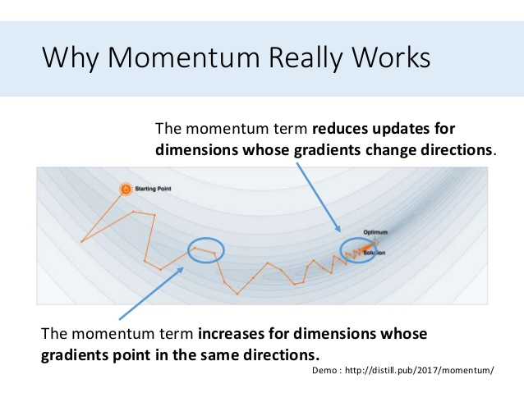

Slide 41
Momentum optimization overshoot
The optimizer may overshoot the local optima, then come back and overshoot again- oscillating before arriving at the minimum. A friction value, typically set to .9 can help rid the oscillations and speed convergence.
optimizer = tf.train.MomentumOptimizer(learning_rate=learning_rate,
momentum=0.9)

Slide 42
Nesterov accelerated gradient (NAG)
Proposed in 1983 by Yurii Nesterov, as a variant of the Momentum optimization.
The ideas is to measure the gradient of the cost function slightly ahead in the direction of the momentum.
optimizer = tf.train.MomentumOptimizer(learning_rate=learning_rate,
momentum=0.9, use_nesterov=True)

Slide 43
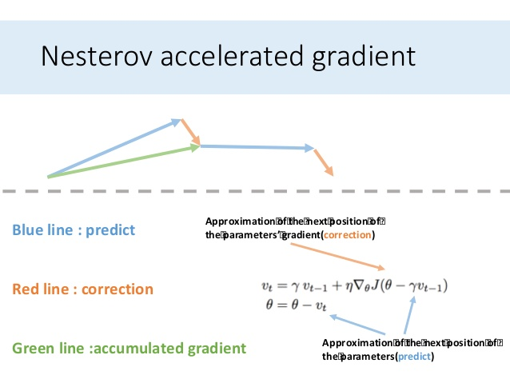
Nesterov results
Nesterov Accelerated Gradient will almost converge to a solution faster than the original Momentum optimization.

Slide 44
adagrad
This algorithm decays the learning rate faster for steep dimensions and slower for dimensions with gentler slopes.
The change in the learning rate is referred to as adaptive learning rate.

Slide 45
Adagrad in practice
AdaGrad results in gradient updates in the direction toward the global minimum better than Gradient Descent.
The learning rate hyperparameter does not require as much tuning as standard Gradient Descent.
AdaGrad performs well for simple quadratic problems.
AdaGrad often stops too early when training neural networks because the learning rate gets scaled down too much and stops.
It should not be used to trained neural networks.

Slide 46
rmsprop
RMSPROP corrects the AdaGrad algorithm from slowing down too fast and never converging to the global optimum.
RMSPROP accumulates the gradients from the most recent training iterations instead of considering gradients across the entire training set.

Slide 47
RMSPROP in practice
The RMSPROP, in most cases, performs much better than AdaGrad.
AdaGrad was the preferred optimization algorithm until the introduction of the Adam optimization.

Slide 48
Adam (Adaptive moment estimation)
Adam was presented by Diederik Kingma and Jimmy Ba in their 2015 ICLR paper titled “Adam: A Method for Stochastic Optimization“.
Adam combines the ideas of Momentum optimization with RMSProp.
Adam is a popular algorithm in the field of deep learning because it achieves good results fast.

Slide 49
Advantage for adam
Straightforward to implement.
Computationally efficient.
Little memory requirements.
Invariant to diagonal rescale of the gradients.
Well suited for problems that are large in terms of data and/or parameters.
Appropriate for non-stationary objectives.
Appropriate for problems with very noisy/or sparse gradients.
Hyper-parameters have intuitive interpretation and typically require little tuning.

Slide 50
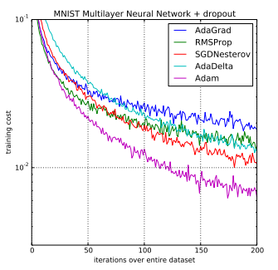
Adam comparison

Slide 51
Reconsidering adam
The Hands-On Machine Learning with Scikit-Learn and TensorFlow book initially recommended using Adam optimization because it was generally considered faster and better than other methods
However in 2017 Ashia Wilson showed that adaptive optimization methods (AdaGrad, RMSProp and Adam) can lead to solutions that generalize poorly on some datasets. It is advised to stick to Momentum or Nesterov for now, until researchers have a better understanding of the issue.

